Slide 1
Gizzy Gallery
Alina Momin, Huzaifa Zia, Rostam Rad, Thomas Wang, Wes Robinson, Zyad Ahmed

Slide 2
About
The Gizzy Gallery system is a virtual photo album that allows users to search, sort and view their photos in various configurations.
The purpose of this system is to create an easy for users to store and sort their photo gallery.

Slide 3
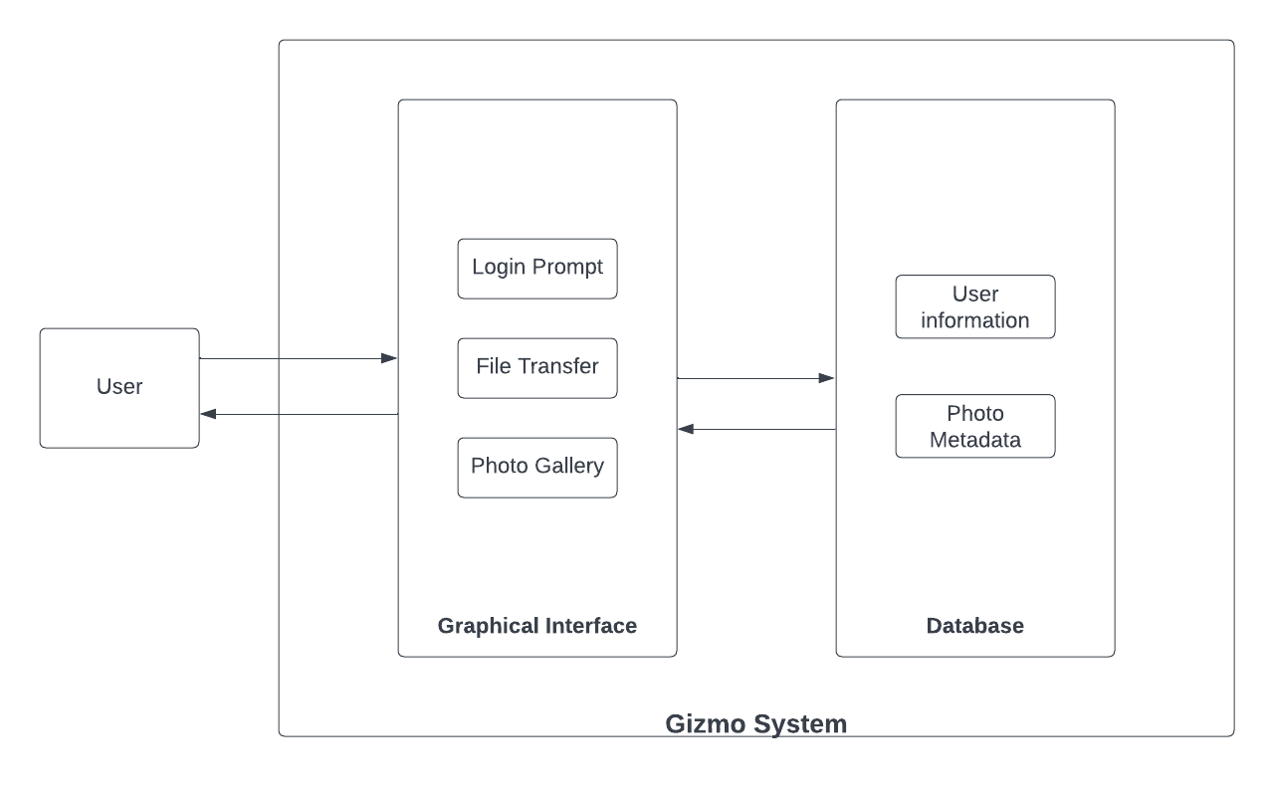
System Boundary Diagram

Slide 4
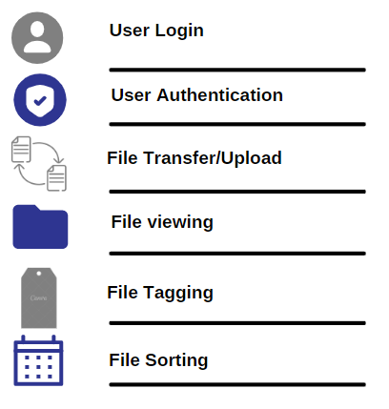
Functionality

Slide 5
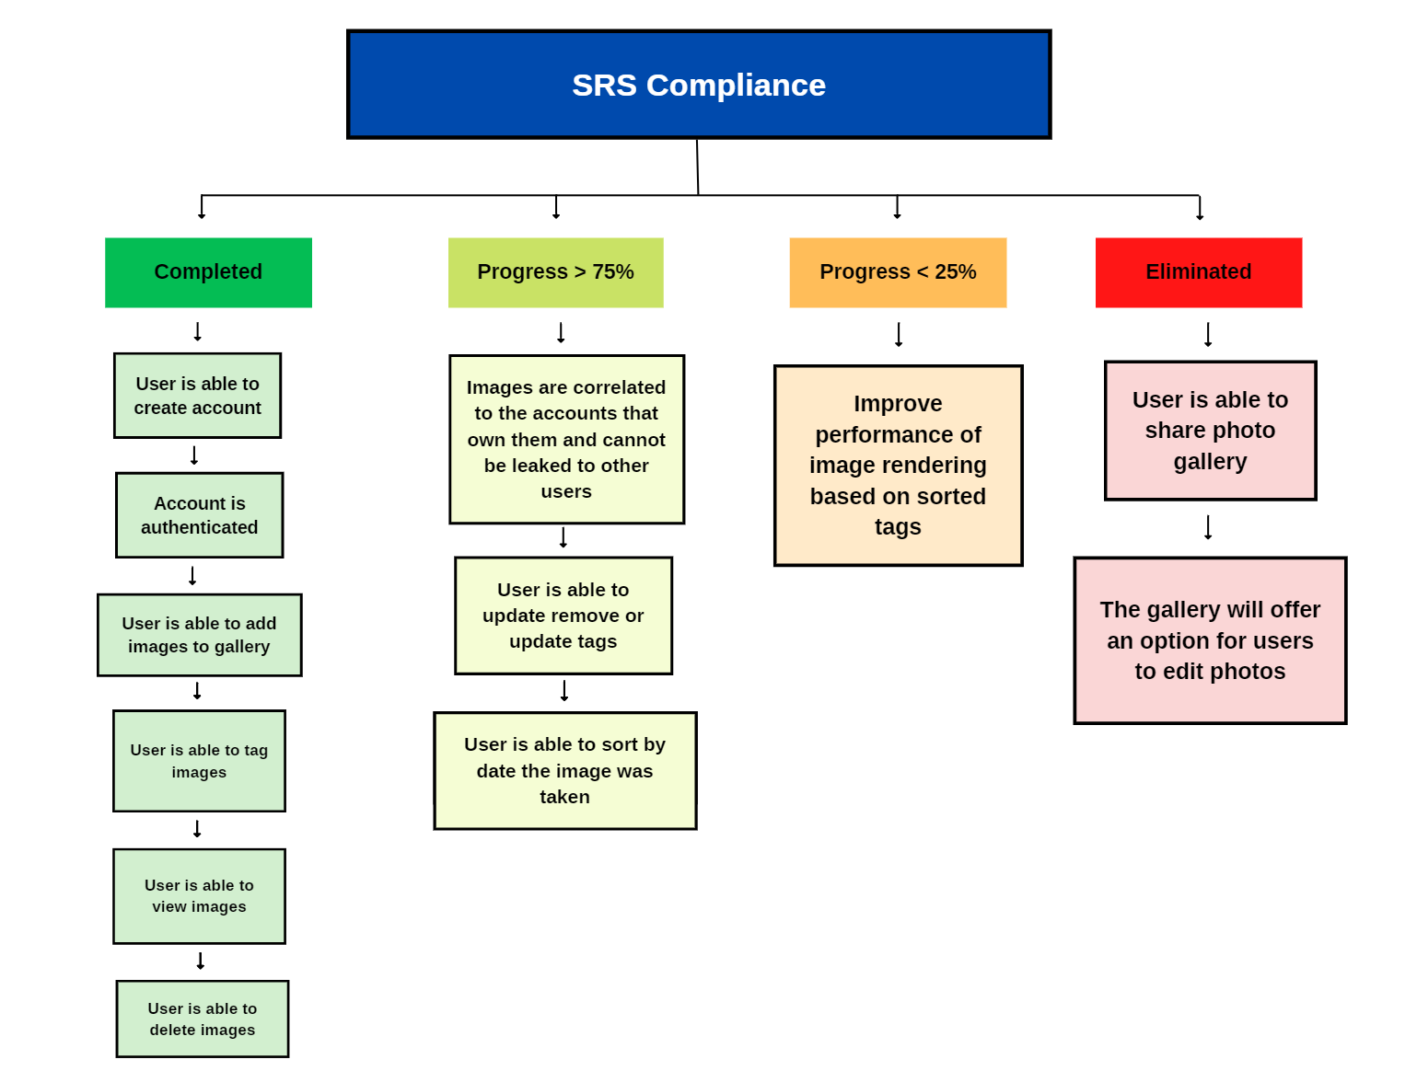

Slide 6
What’s our Tech Stack?
Programming Language(s)
Javascript, CSS, HTML
For the our frontend, we will use React JS to deal with UI and UX design.
For our backend use firebase and firestore
Our app runs in the browser so for compatibility we’ll focus on compatibility when working on Chrome

Slide 7
System Requirements Specification
Image Streaming
If there are too many images load in at once, the software must be able to stream images from the disk or the API endpoint in order to have a smaller memory footprint.
Image Processing
To increase metrics by which to sort images, the software can use various forms of image processing to provide different ways of collating images (like sorting by colors).
Possible to use machine learning to further process images and categorize them.
Security
Secure sign-in (only store hash and salt).
Keep images correlated to the accounts that own them and not leak them to other users.
Only allow authenticated user to view certain pages
Notes:
Image Streaming: Images can be rather big and since we do not know the size of the images beforehand, this will provide a catch all solution to the potential memory problems.
Having these requirements increase the robustness of the software.

Slide 8
System Requirements Specification
Quality UI
Create a user interface that is easy to follow and interact with.
Have access to a Dark Mode.
Simple Code
Try to minimize the amount of code to keep the potential bug footprint down.
Trash Bin
Let the users have the ability to empty out their Trash Bin is permanently discard their photos
.
Notes:
These are some niceties that I think would be pretty beneficial to the quality of our product. These requirements are not necessary for the functionality of the software, but greatly contribute to it.

Slide 9
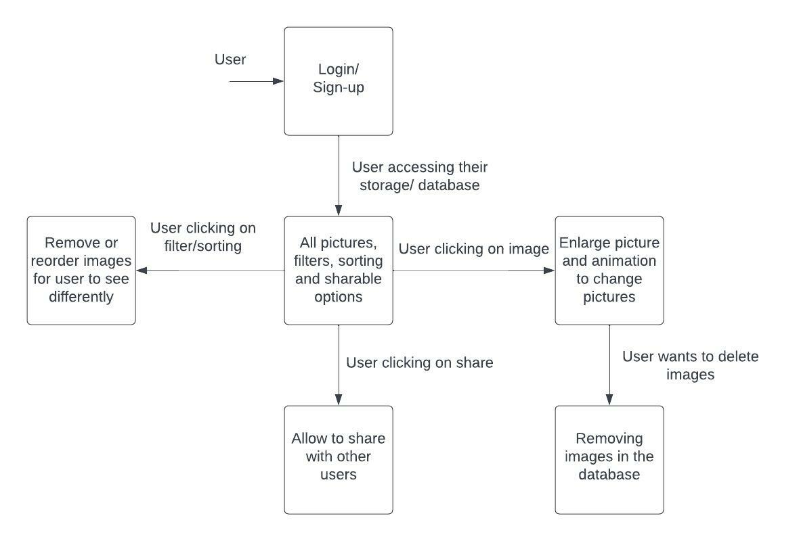
Data Flow Diagram

Slide 10
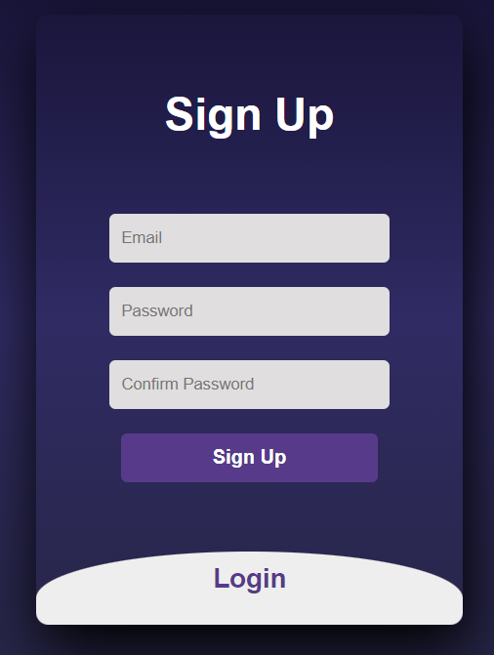
UI design
Simple Design
Allow users to log in/create an account
Sync data across different devices
Allow users to add photos to gallery
Authenticate user
Notes:
Kept the login screen simple to not overwhelm the user.

Slide 11
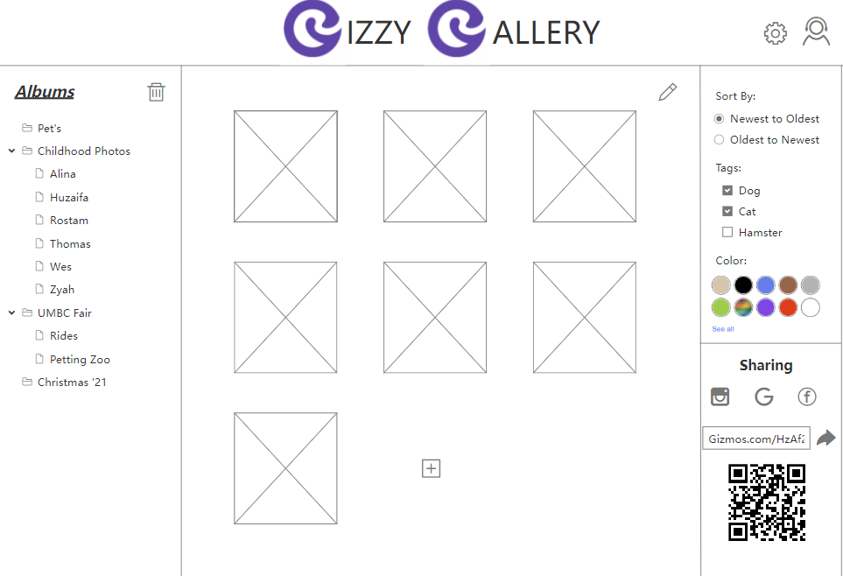
Notes:
S

Slide 12
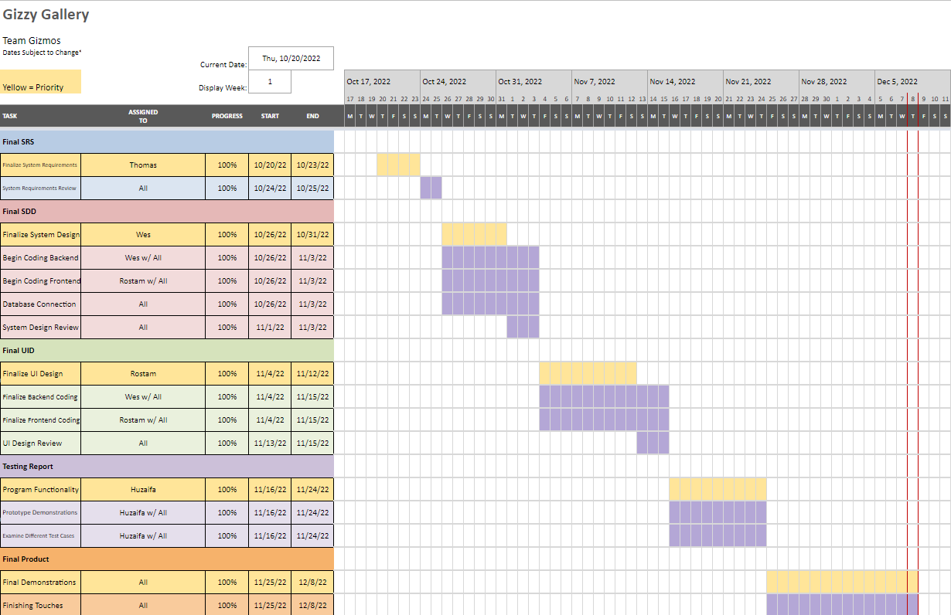
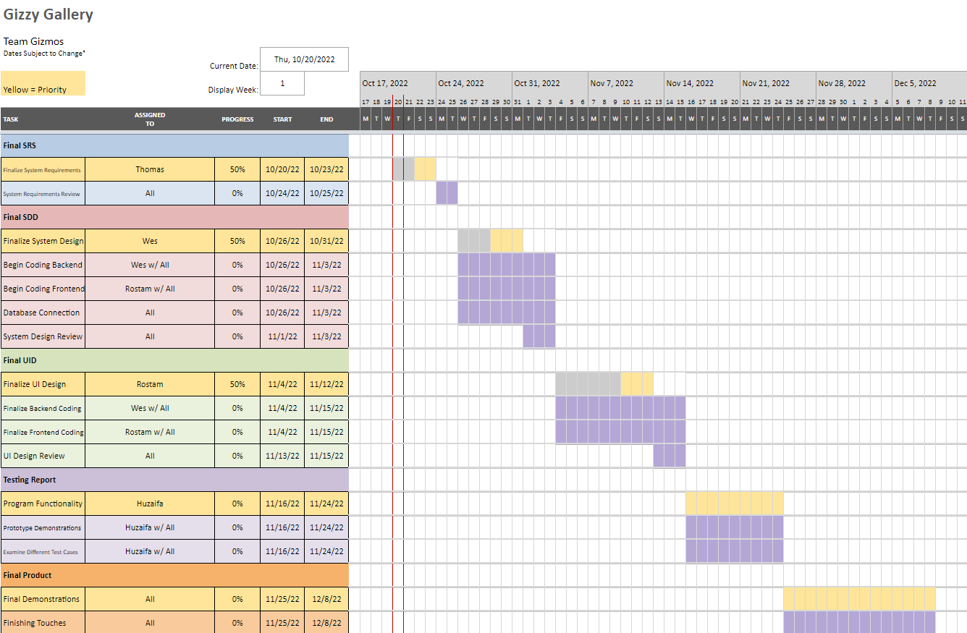
Plans (priorities and timelines)

Slide 13
Challenges
Everyone had different coding skills
Finding implementations for filtering that were effective for our gallery
Getting teams skill levels up to speed
Learning Git skills: https://www.youtube.com/watch?v=18gA0PB6mBw
CSS challenges with cascading code
Learning Firebase

Slide 14
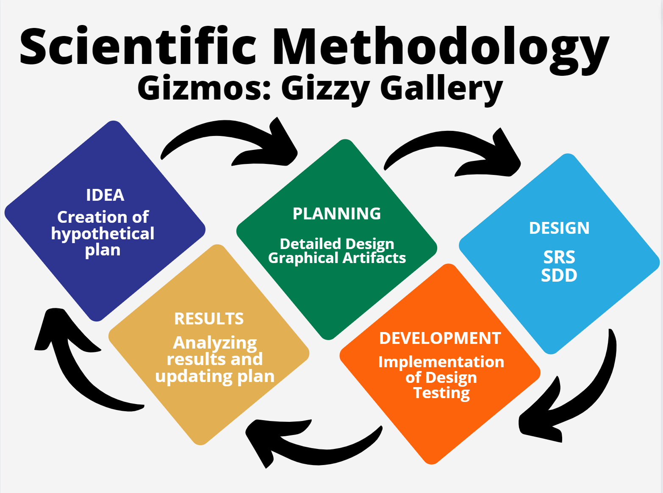
Project Management
Discord: Communications, task management, online work hours, debugging, code collaboration
Git/Github: Version control, collaboration on code

Slide 15
Thank You!
Questions?

